Slide 1

PHILATELY BULGARIA · NEW GENERATION
Introduction to
Philately
BULGARIA · БЪЛГАРИЯ
PHILATELY
A presentation in 13 slides
The science, the art and the passion for history's smallest documents
1879
Author: Mihail Petrov
Notes:
Welcome. Today we will look at philately as a hobby, a science and a cultural discipline — from the origin of the term to today's digital trends and the Bulgarian tradition.

Slide 2
What philately is
Definition and origin of the term
Philately is a science, an art and a hobby devoted to the study and collecting of postage stamps and postal material.
ORIGIN OF THE WORD
philos
love
+
atelia
exemption from charge
Today philately is a cultural and historical discipline with a global community of collectors, researchers and institutions.
A stamp is at once a payment document, a historical source and a work of graphic art.
from Greek
Notes:
The term was coined in the 19th century. The second element points to the fact that the prepaid postal charge frees the recipient from paying — hence the meaning of the stamp as a receipt.

Slide 3




Why philately matters
Four core arguments
Miniature documents
A mirror of its age
Every stamp is evidence of its own time — date, rate, country and event.
They reflect politics, culture, science, art, sport and technology.
An educational tool
National identity
Useful to students, collectors and researchers across many disciplines.
They sustain cultural heritage and the memory of a society.
Notes:
Stress that stamps are a primary historical source: they date, locate and certify events in a way few other mass-produced objects can.

Slide 4






Main branches of philately
Six established fields of collecting
Classical
Thematic
Maximaphily
Early issues, rare stamps and classic postal histories.
Collections built on a theme: animals, space, music, sport.
Picture postcards matched in theme to the stamp and cancel.
Postal history
Aerophilately
Revenue
Routes, postmarks, rates and postal services.
Airmail and the history of aviation routes.
Fiscal and revenue stamps outside postal use.
Notes:
The branches are not mutually exclusive — many collectors combine thematic philately with elements of postal history.

Slide 5






What philatelists collect
From a single stamp to the whole cover
Postage stamps
used and unused
Covers and postcards
including first day covers (FDC)
Postmarks and cancels
rate documents and certificates
The object of a collection
Entire covers
Value lies not only in the stamps, but in everything that tells the journey of the item.
routes, express and military mail
Literature and catalogues
specialist literature and albums
Notes:
The entire cover is often worth more than the stamp torn off it, because it carries the rate, the route and the date.

Slide 6
How a philatelic collection is built
Five consecutive steps
1
2
3
4
5
Theme
Sourcing
Arranging
Describing
Story
Choose a theme or branch that genuinely interests you.
Material from catalogues, auctions, clubs and online platforms.
Mounting in albums or preparing an exhibit.
Date, issue, cancel and rate information for every item.
Building the logic and the narrative that ties the material together.
A good collection is not a pile of objects but research with a clear thesis and consistent logic.
Notes:
Emphasise step 5: exhibition juries reward the narrative and the research, not just the value of the material.

Slide 7




International philatelic organisations
The institutional framework of the hobby
FIP
Fédération Internationale de Philatélie — the world federation that sets the rules for exhibitions.
FEPA
Federation of European Philatelic Associations — the European organisation of the national federations.
National federations
They unite the clubs within each country and organise the national exhibitions.
Museums and archives
The British Museum and the Smithsonian Postal Museum preserve and study world collections.
Notes:
Membership of a national federation is the practical door to international exhibitions — qualification normally runs through the national level.

Slide 8

Philatelic exhibitions
Levels, classes and judging
Levels
Awards
National, regional and international exhibitions.
Classes
Traditional philately · Thematic · Postal history · Philatelic literature.
Judging criteria
Content and importance of the material
Originality of the concept
Depth of research
Technical execution and presentation
Bronze
Silver
Vermeil
Gold
Large Gold
The ascending scale of awards
Notes:
Judging is by points on a fixed scale. The award goes to the exhibit, not to the collector — the same material can score differently if it is arranged differently.

Slide 9
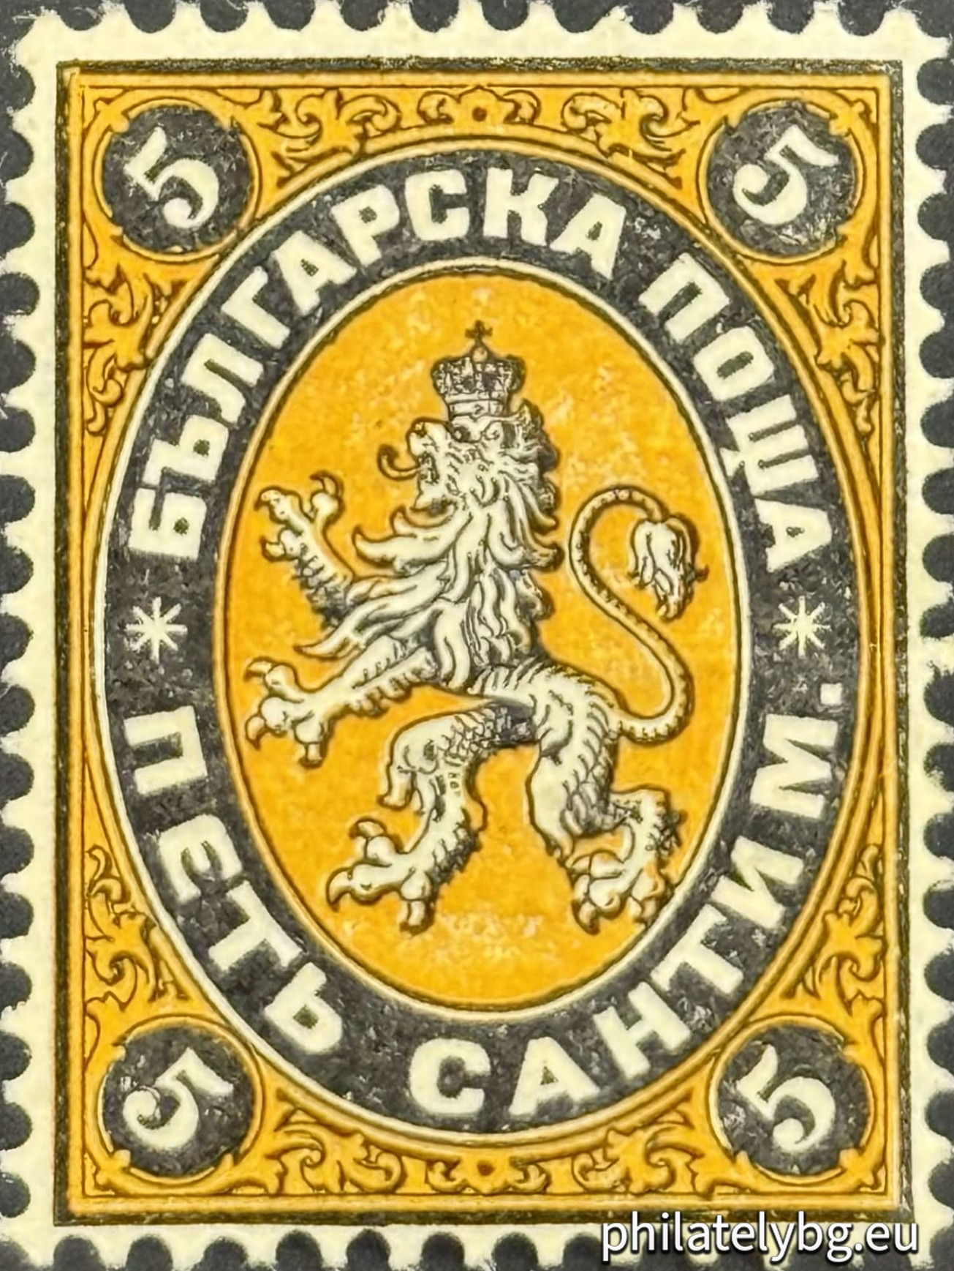
Bulgarian philately
A tradition that began in 1879
FIRST BULGARIAN STAMP
A rich history
1879
Royal issues, military posts, airmail and rare cancels.
An active community
„SANTIMI“
Clubs, federations and constant international participation.
The start of the national postal issue
Modern issues
Stamps of high artistic and printing quality.
Bulgarian issues are sought after on the international market for their historical density.
Notes:
The 1879 „Santimi“ issue, bearing the Bulgarian lion, is the first issue of the Principality of Bulgaria. The military posts of the early 20th century and airmail are among the most researched fields in the country.

Slide 10
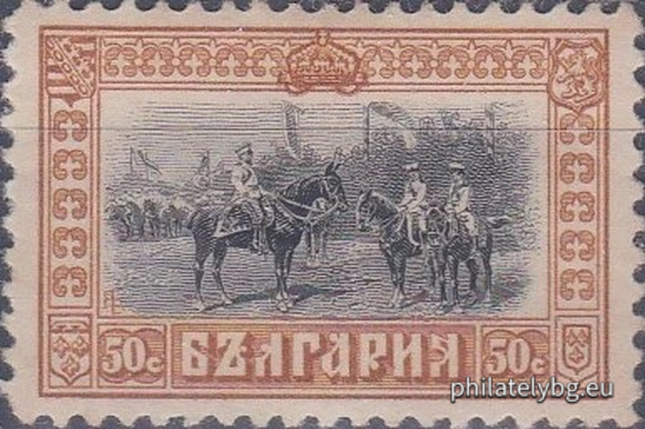
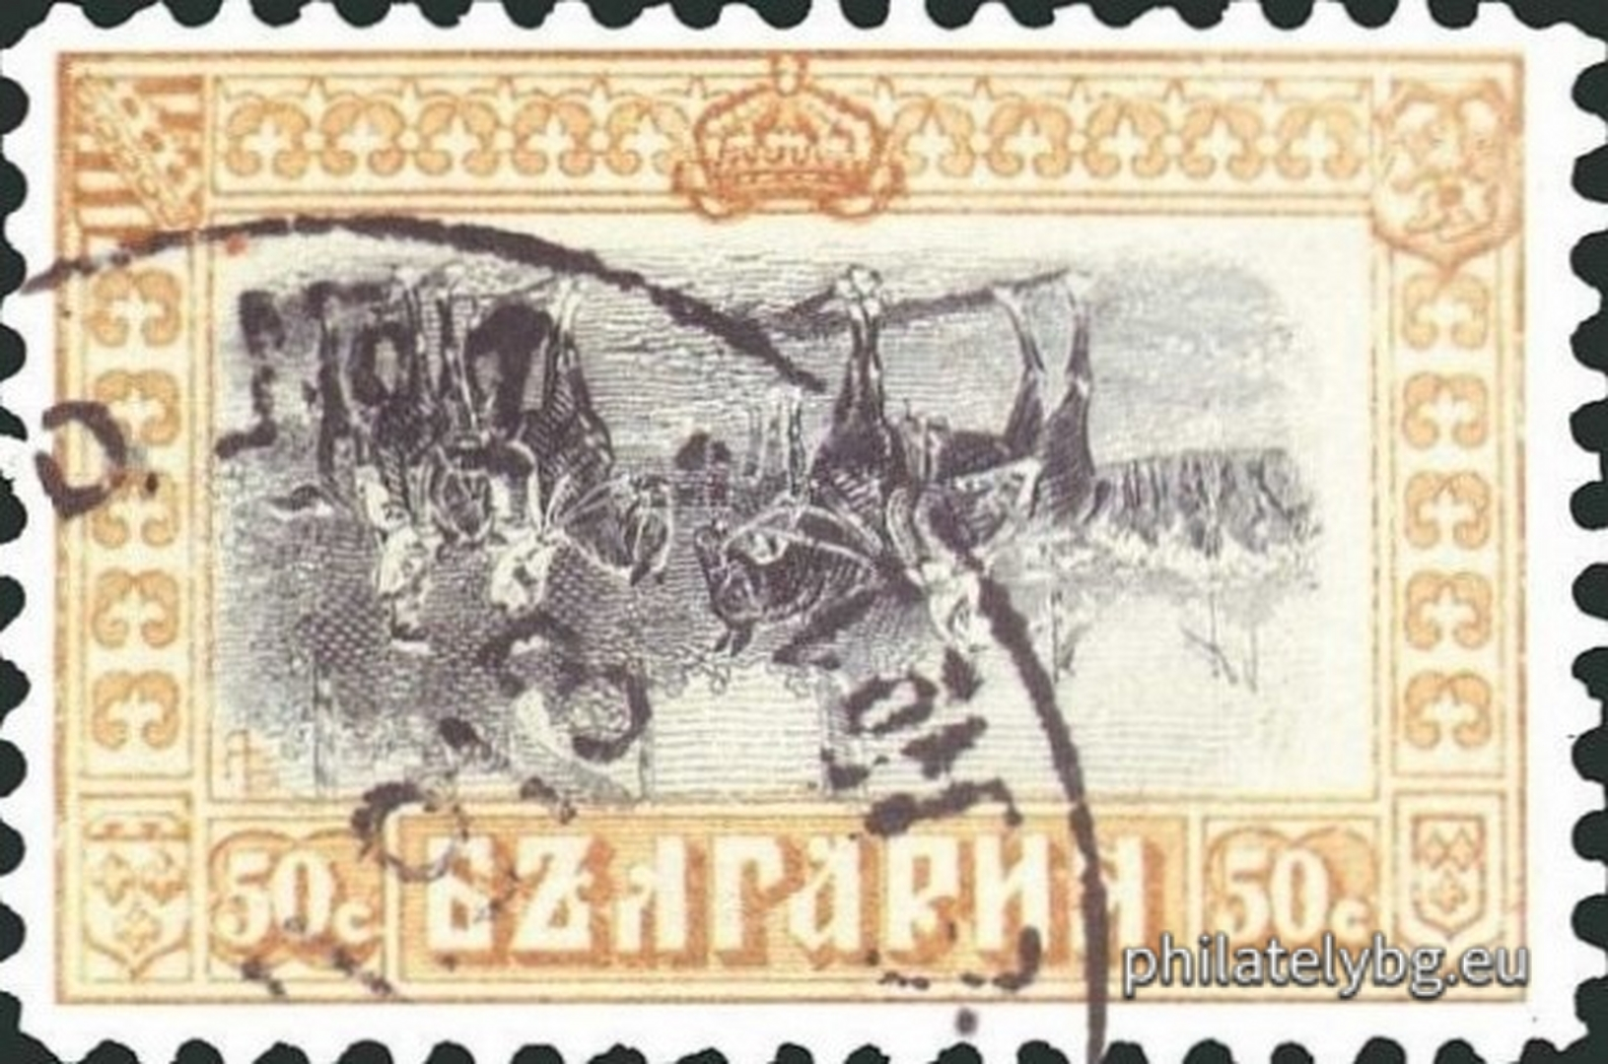
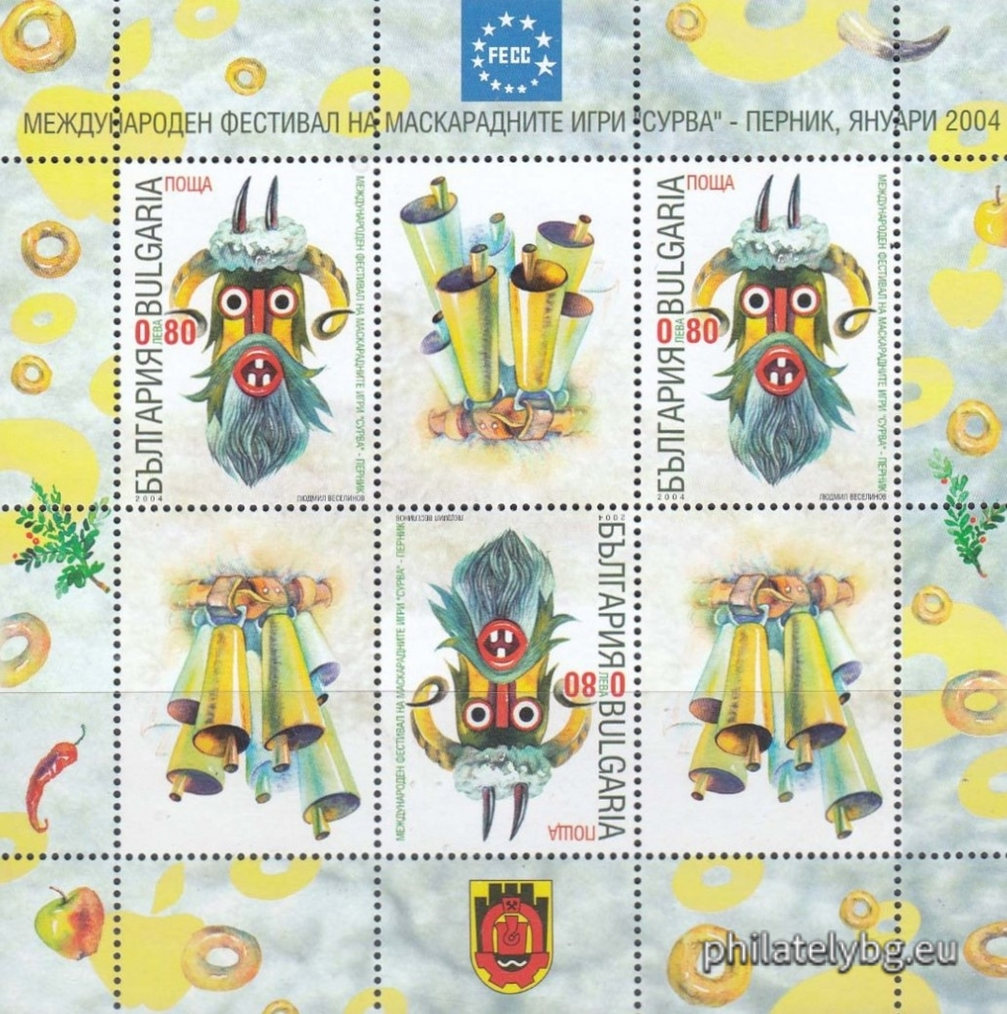
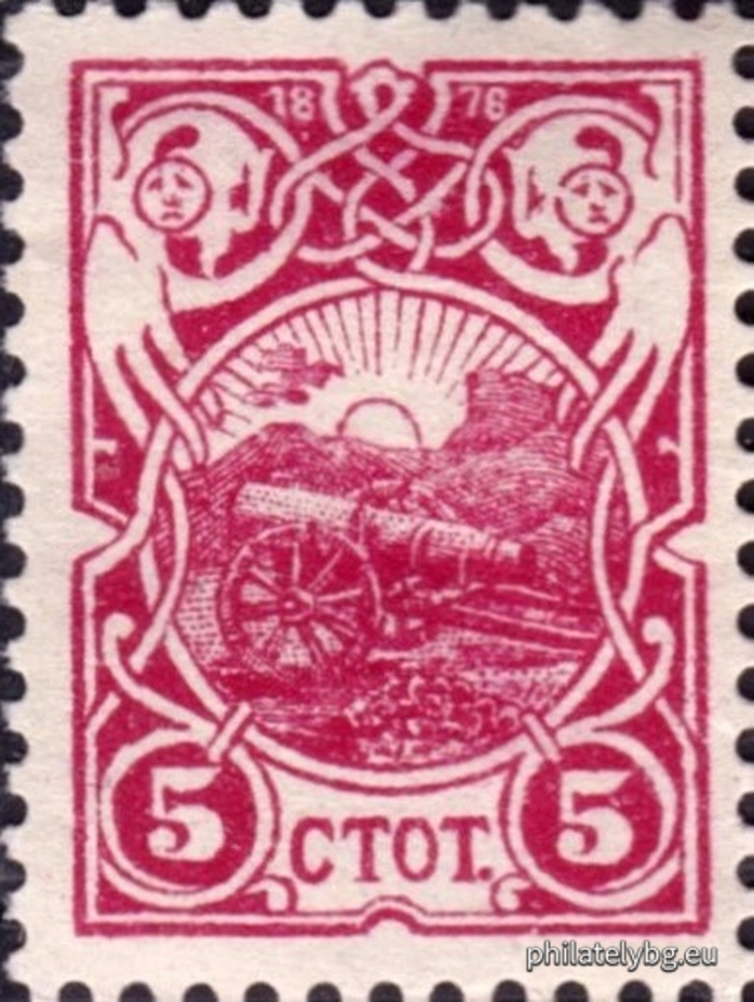
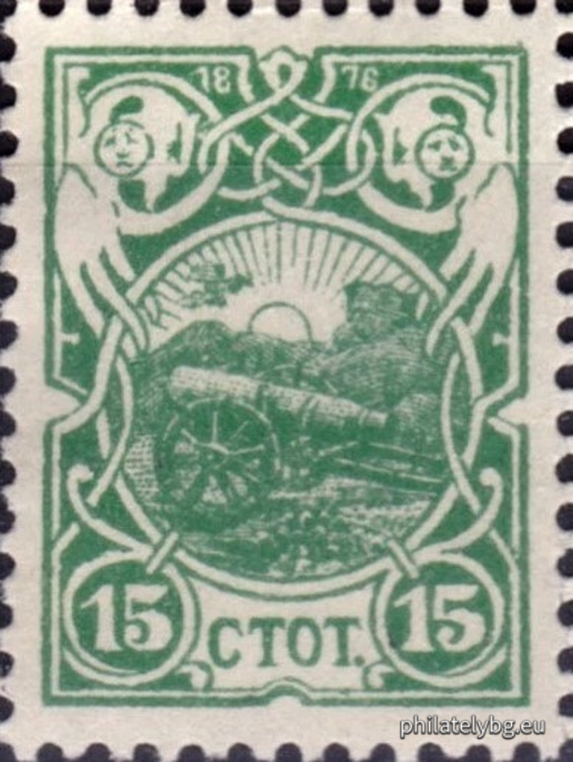

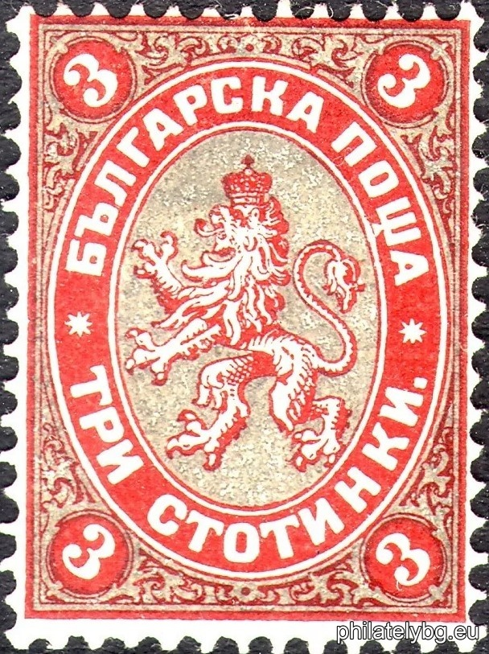
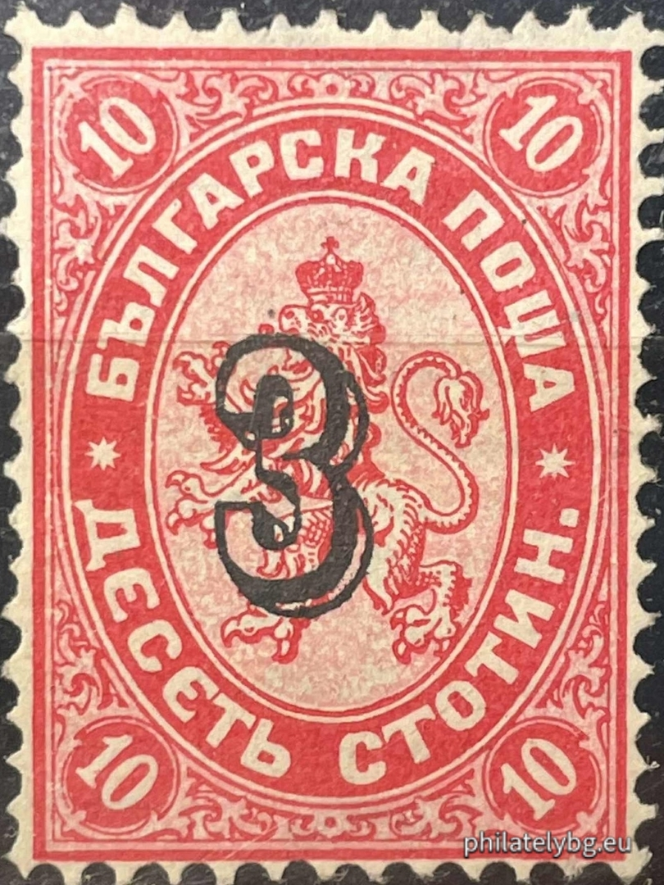
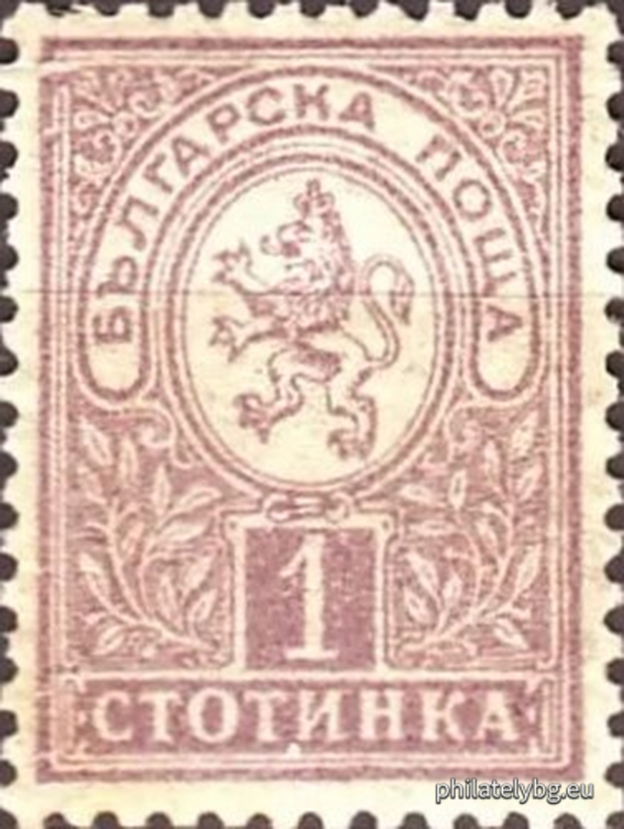
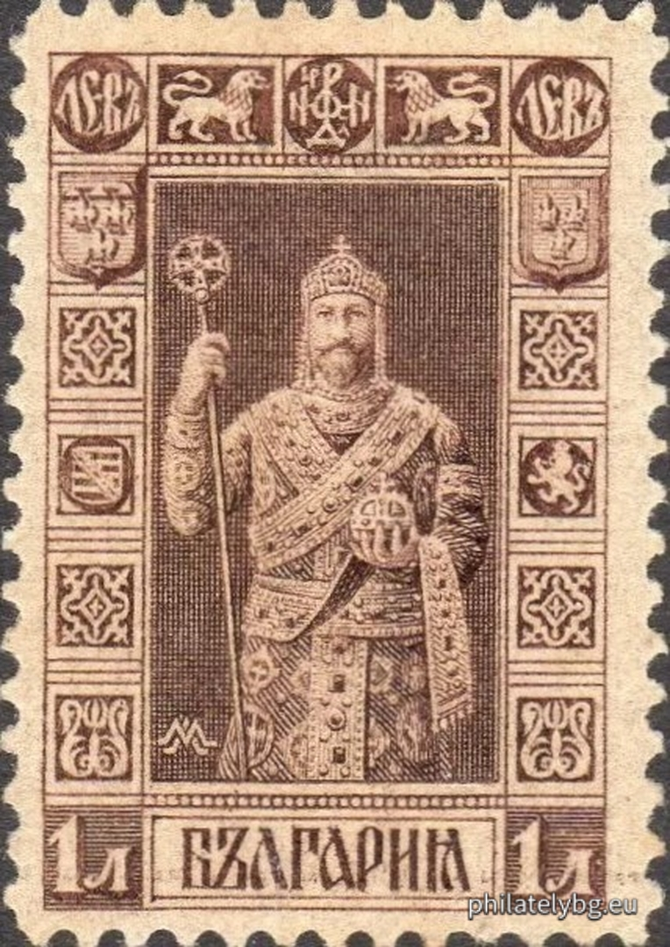
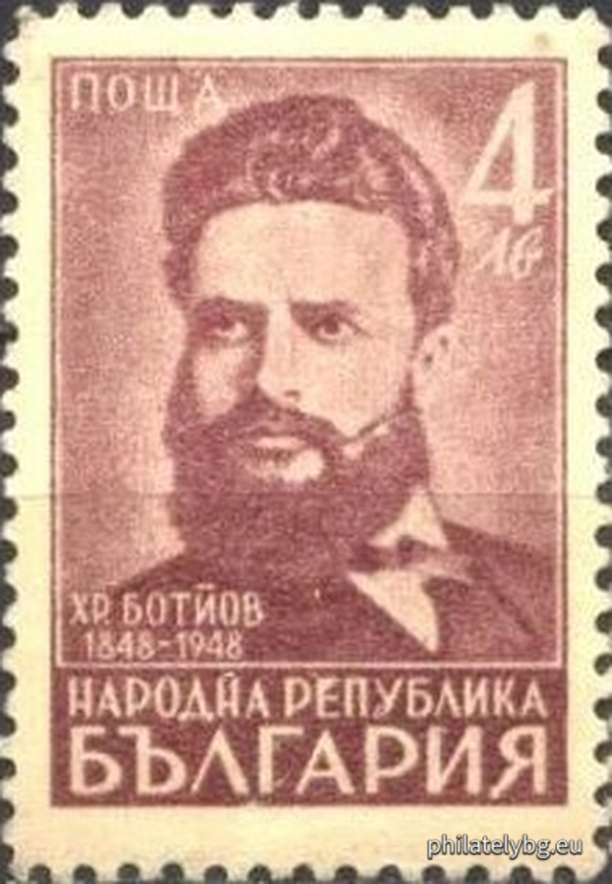
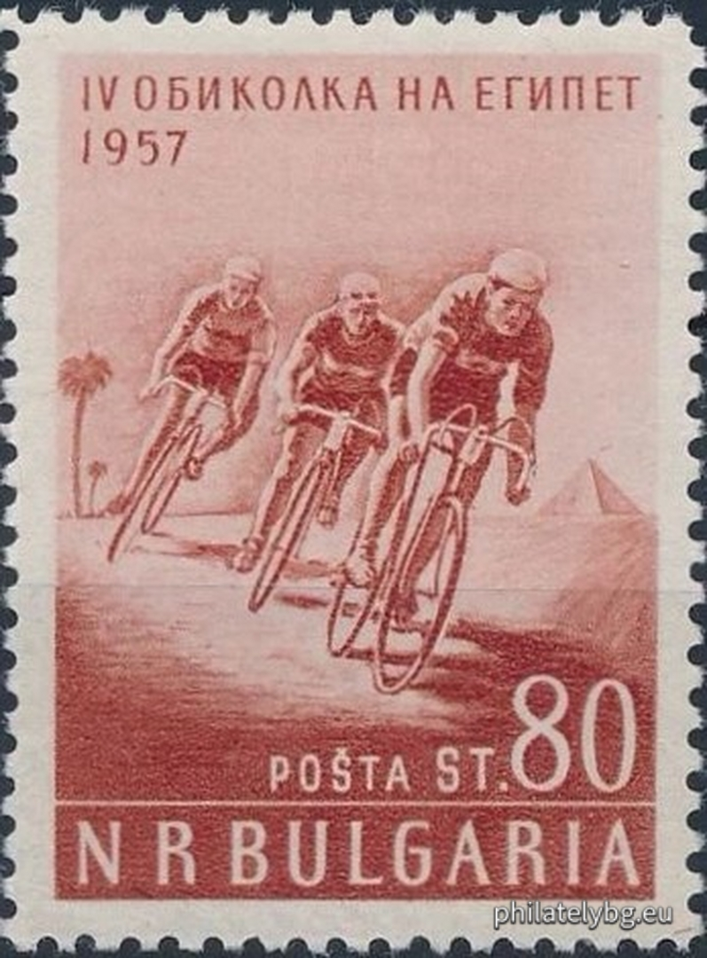
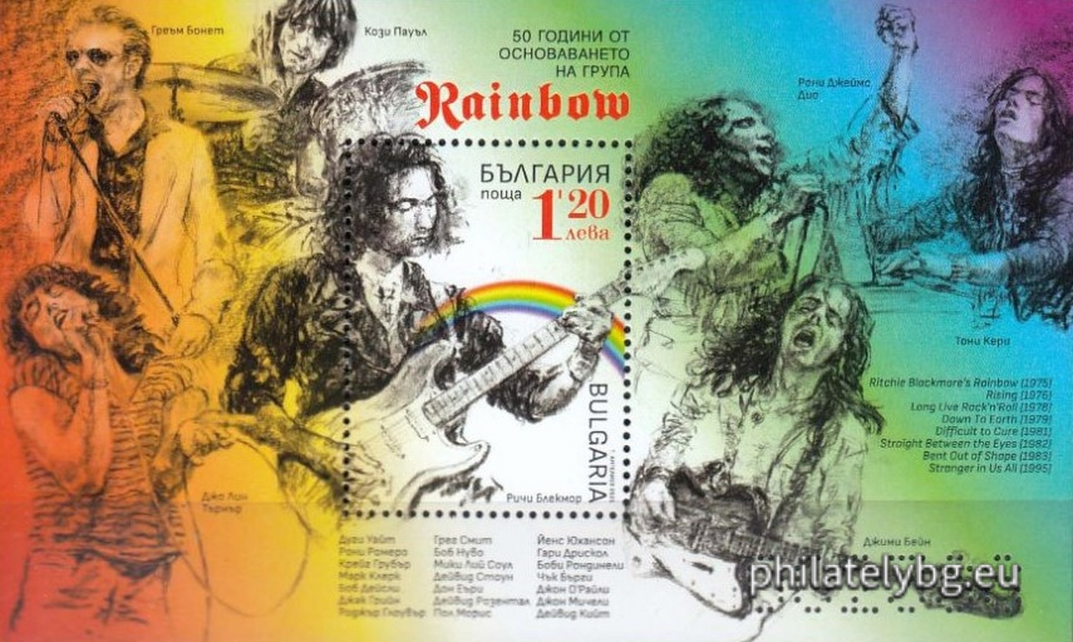


Better-known Bulgarian stamps
1
„Views and Portraits“
The Inverted Cavalry
3
International Festival of the Masquerade Games " Surva ", Pernik
BK 90K1 · 1911 · error · Y. Veshin
BK 4627 · 2004 · mini-sheet
artist Lyudmil Veselinov
issued stamp
error
(inverted centre)
2
25 years since the April
Uprising of 1876 (Cherry cannon)
4
50 years of a woman in space
BK 5070 · 2013 · souvenir sheet
artist Rosen Toshev
BK 51-52 · 1901 · two postage stamps
artist Haralampi Tachev
Notes:
Item 1 is an error — the inverted centre from the 1911 „Views and Portraits“ issue; the sheet went through the press the wrong way round on the second printing, which is why it is worth thousands. Items 2 to 4 show three different reasons to collect: national memory, living folklore and science. Catalogue reference: philatelybg.eu

Slide 11




Modern trends
How technology is changing philately
Digital catalogues
Scientific methods
Virtual exhibitions
New themes
Online archives and databases make research instant and available anywhere.
FTIR, Raman and spectral analysis of paper and inks for expertisation.
Digital exhibits reach an audience with no geographical limits.
Space, technology, ecology and contemporary cultural events.
Digitisation does not replace the original — it widens access to the knowledge about it.
Notes:
Spectral methods are now standard in the expertisation of rare stamps — they reveal repairs, forged overprints and replaced paper.

Slide 12

How to begin
A practical plan for the first months
1
Choose a theme that genuinely interests you.
KEY CATALOGUES
2
Buy a basic album and the standard catalogues.
Michel
Scott
3
Visit a local club or an online community.
FEPRA (BG)
4
Build the collection gradually and consistently.
5
Take part in exhibitions and seminars.
The catalogue is every collector's first reference tool.
Notes:
Advise beginners to start with one clearly limited theme — too wide a scope at the start leads to scattering and loss of interest.

Slide 13
Conclusion
Philately is a journey through history, combined with research, creativity and collecting passion.
Thank you
for your attention!
It is a hobby that builds knowledge, culture and an eye for detail.
Welcome to philately — the world of the small but significant documents of human civilisation.
Mihail Petrov · Philately Bulgaria – New Generation
Notes:
Close with an invitation to the audience: the best way to understand philately is to look closely at one real exhibit.

